Slide 1
PAYCHAT

Slide 2
Problems
Cost sharing for group activities is complicated
Too many information: what have been paid, what amount, who has paid and who have to share
Too many transactions per person: one has to paid many times, to many people before the cost can be canceled out.
Eg: with Blinky app, a person who has logged a number of expenses will get paid from many people. The same happens with others who log some other expenses. Hence, the number of transactions is huge.
Cost sharing for group activities is embarrassing
How to announce the cost to all participants, quickly?
Friends forget to pay? How to ask for payback in style, and naturally?

Slide 3
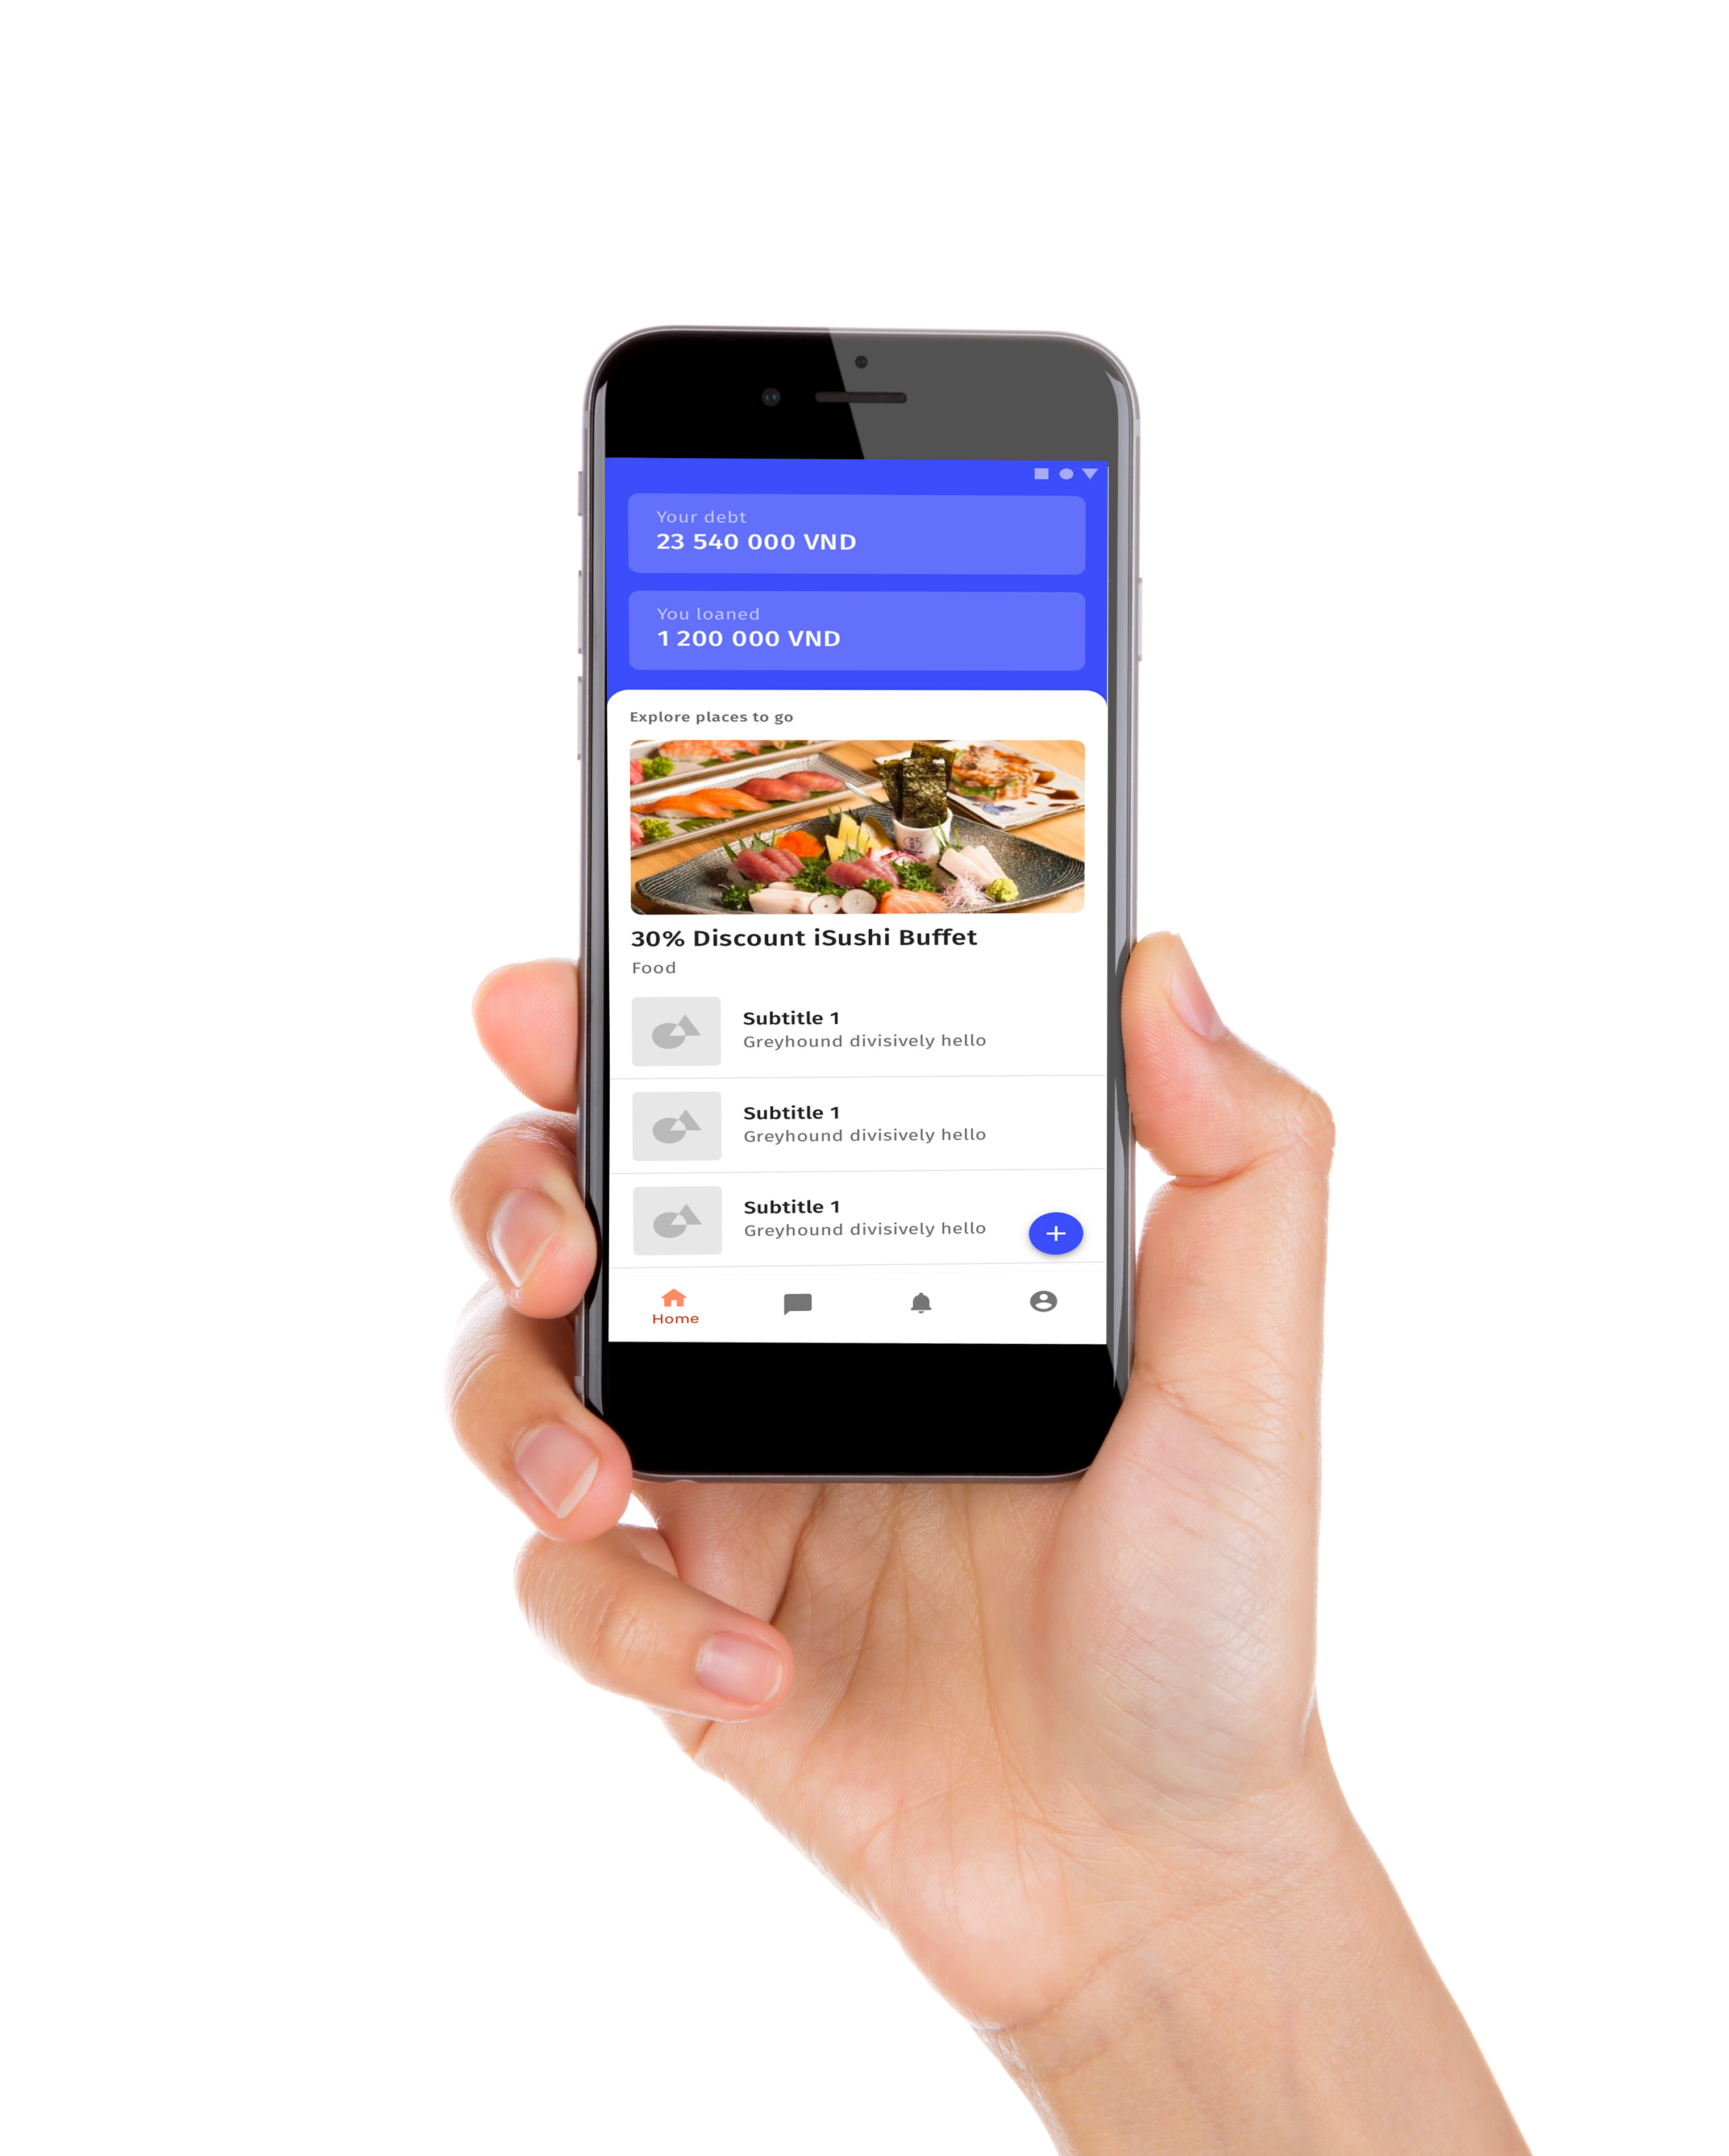
Solution – Pay Chat concept
A group spending application that brings head-to-toes convenience & joys for a group of friend when it comes to any activity – even it’s a hangout, a trip, a party or just a lunch.
PLANNING
CARE
LESS
CHITCHAT
MORE
Chat
Ball
FINDING OFFERS
GOSSIP
SHARE COST

Slide 4



Solutions
A chatroom for a group of friends to gather and discuss everything relating to an activity: planning, preparation, gossiping, and most important - recording expenses and calculating individual cost.
MIND YOUR
OWN WALLET
MAKE ONE
TRANSACTION
KEEP HEALTHY FRIENDSHIP
The only information one has to bear in mind is the amount they take out of their wallet.
Only one transaction to one person - all your cost & deposit in group activities cancel out.
Avoid awkward situation when you have to ask for payback.
Paychat do it for you, no asking back an forth, no confusion and no embarrassment.

Slide 5
Customer flow
Open Pay Chat
Create activity
Chat group created. Invite friend to join
Gossip, plan the time…
Spend money
Log the expenses to the chat
Friends “hand up” to share.
Take the one and only action to pay.
Before activity
After activity

Slide 6

How it works
expenses
Pizza
Cinema
Parking
5
3
2
Pizza
500,000
5
Cinema
Logging expenses via group chat messages
800,000
3
Letting friends to mark themselves as “involved” in each expense via “Hand up” function.
Thank guys for paying. I’ve handed up in all my cost.
Parking
80,000
Pin logged expenses to the top of chat box
2
Sorry I forgot this. Hand up so that you can be counted in!
Auto-return individual COST and BALANCE
Auto-return the one and only action per participant has to take to resolve all debt and lending.
Start calculating

Slide 7
Mathematical logic
Expense will be split equally for all “hand-up”
5
Individual cost is summarized from the partial cost of the expenses they have “handed up”
INDIVIDUAL BALANCE
INDIVIDUAL ACTION
Individual cost
-
Individual deposit
Pizza
Individual deposit is summarized from the expenses each person log on.
500,000
5
A
<
B
<
C
<
D
<
E
Negative balance
Positive balance

Slide 8
Mathematical logic
A
<
B
<
C
<
D
<
E
Negative balance
Positive balance
People with cost bigger than deposit will have a positive balance and need to pay exactly their balance to make it returns to Zero.
People with cost smaller than deposit will have a negative balance and need to receive exactly their balance to make it returns to Zero.
RULES: all people with positive balance pay to the person with lowest balance. After receive all payback, that person pay others who have negative balances an amount equal to their balance.
MAXIMUM NUMBER OF TRANSACTIONS (IN WHATEVER CASE): X -1 ( X is the number of group member)

Slide 9
Product prospects
IMPROVE THE CHAT
SERVICES INTEGRATION
Various “reactions” to handle more complicated cases: “hand-up”, “paid”
Integrate with bank to make payment easy.
Connect activity with place offerings.
Allow “mentions” in expenses logging to mark people whose the expense belongs to.
Integrate with restaurant’s menu -> Allow individual order.
Scan bill – auto-detect single expense and auto log it so that people can “react” quickly
Fun features: “Report” people, throw eggs/tomato to long payback.

